Slide 1

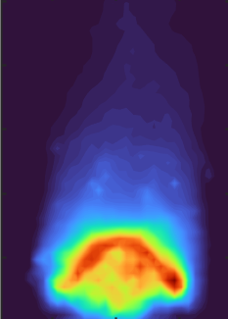
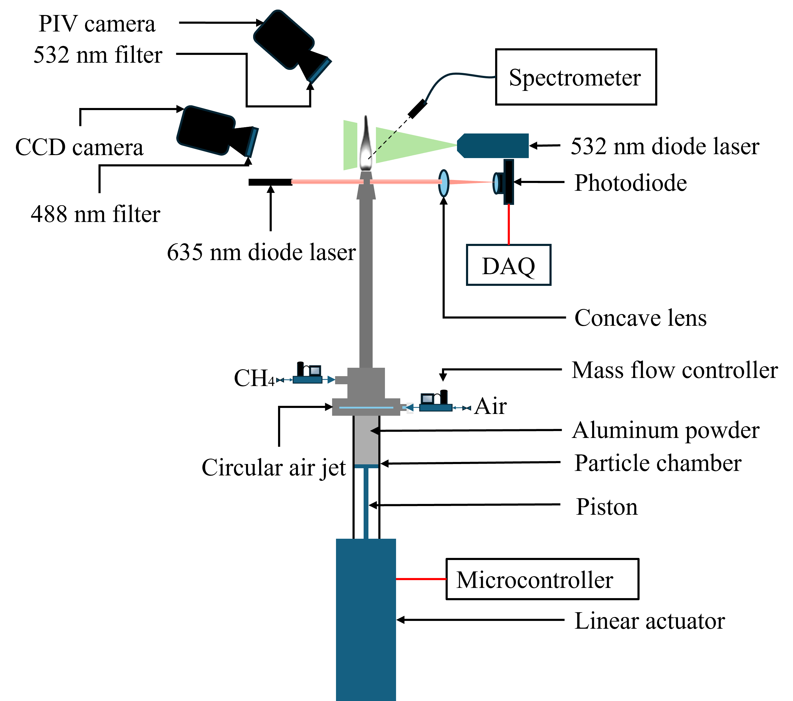
Combustion And Hydrolysis Of Metal Particles For Recyclable Energy With Zero-carbon Emissions
Investigating metal fuel flames as a recyclable, carbon-free energy carrier for next-generation sustainable energy systems.
Studying multiphase combustion phenomena in particle-laden and hybrid fuel flames to advance the understanding of reactive flow physics.
Exploring combustion chemistry, flame dynamics, and stability to enable cleaner and more efficient combustion technologies.
Developing and applying advanced optical diagnostics for quantitative flame characterization and detailed reactive flow analysis.

Slide 2
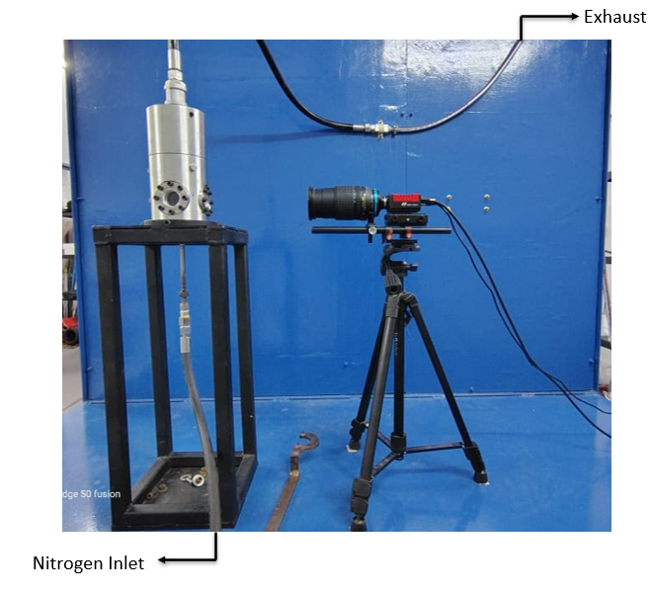
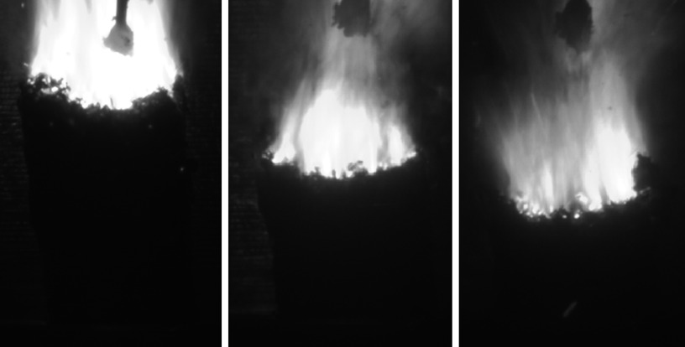
Investigation on Combustion Characteristics of Composite Solid Propellants with Metal and Metal Hydride Additives
Metal additives in composite solid propellants - Aluminum (Al), Magnesium (Mg), and Boron (B)
Micro-sized vs. nano-sized metal additives - Effects on burning rate and agglomeration
Metal hydride-based composite solid propellants - LiAlH₄, MgH₂, TiH₂, and ZrH₂
Combustion characterization - Burning rate, high-speed flame imaging, and agglomerate analysis
Experimental and thermochemical evaluation of advanced energetic additives for solid rocket propulsion

Slide 3
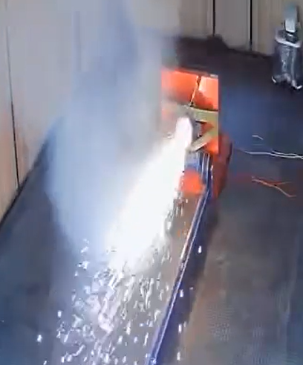

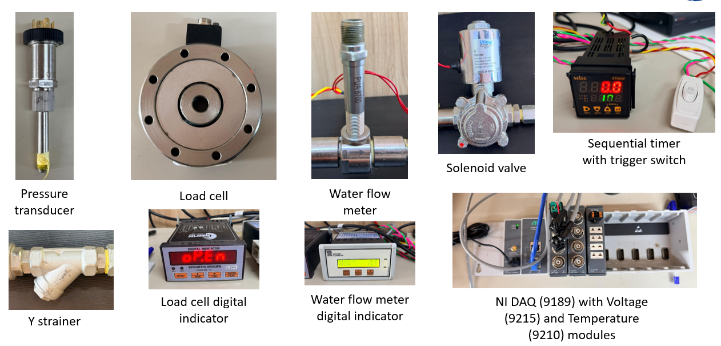
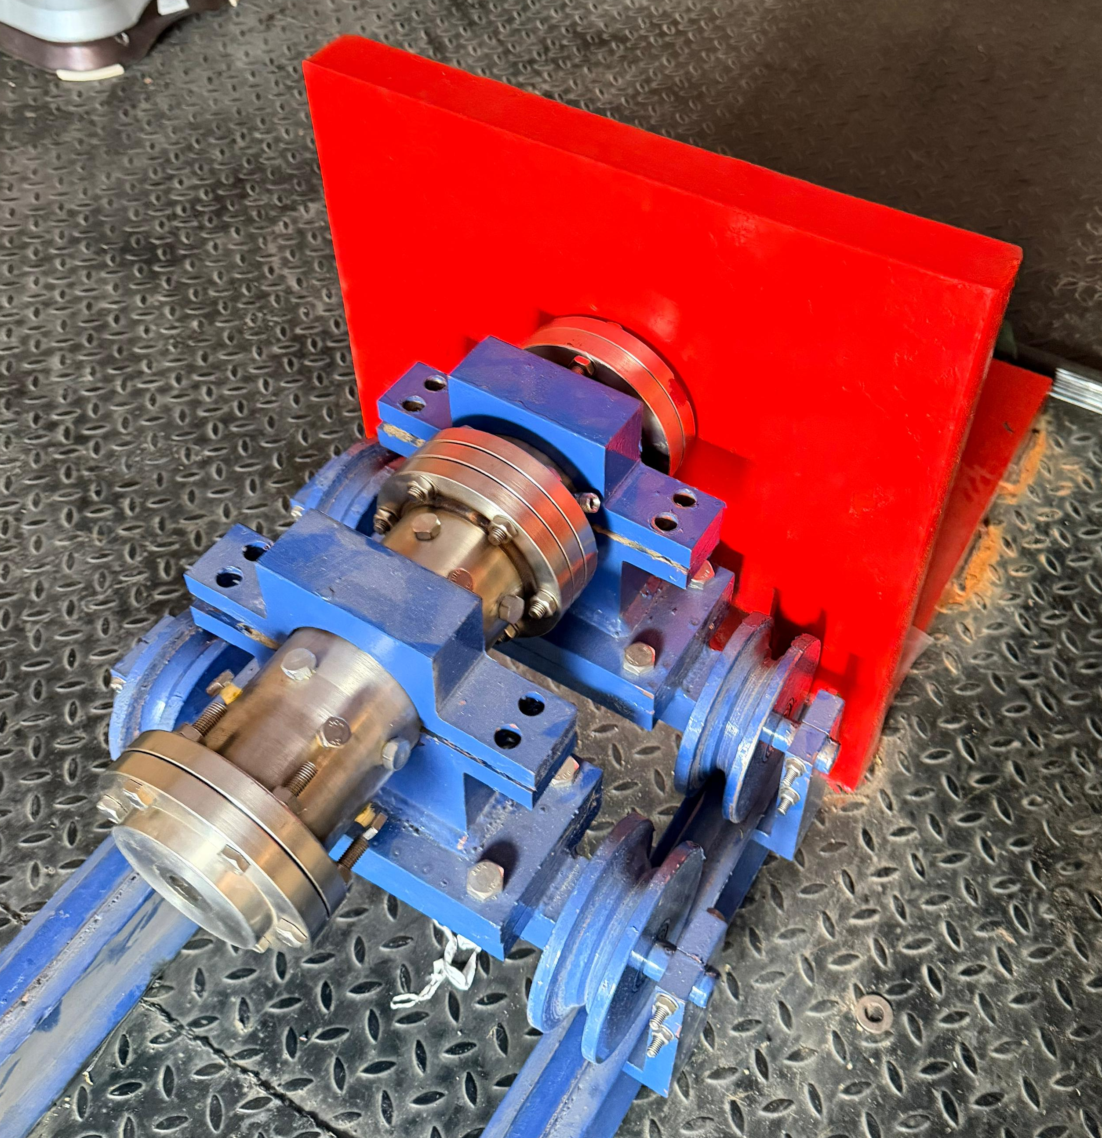
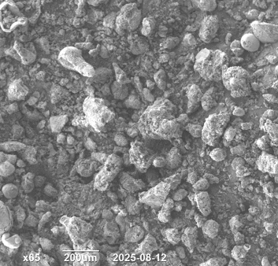
Investigation On Metallized Hydro-reactive Propellants And Propulsive Performance Of Water Breathing Ramjet Engines
Developing advanced metal-based propellants for underwater propulsion systems.
Studying how hydro-reactive propellants burn and perform underwater.
Designing and testing water-breathing ramjet engines for better performance.
Improving thrust, burn rate, and engine efficiency through experiments.
Using advanced testing techniques to understand combustion and propellant behavior.
Building safer, more efficient, and high-performance underwater propulsion technologies.

Slide 4
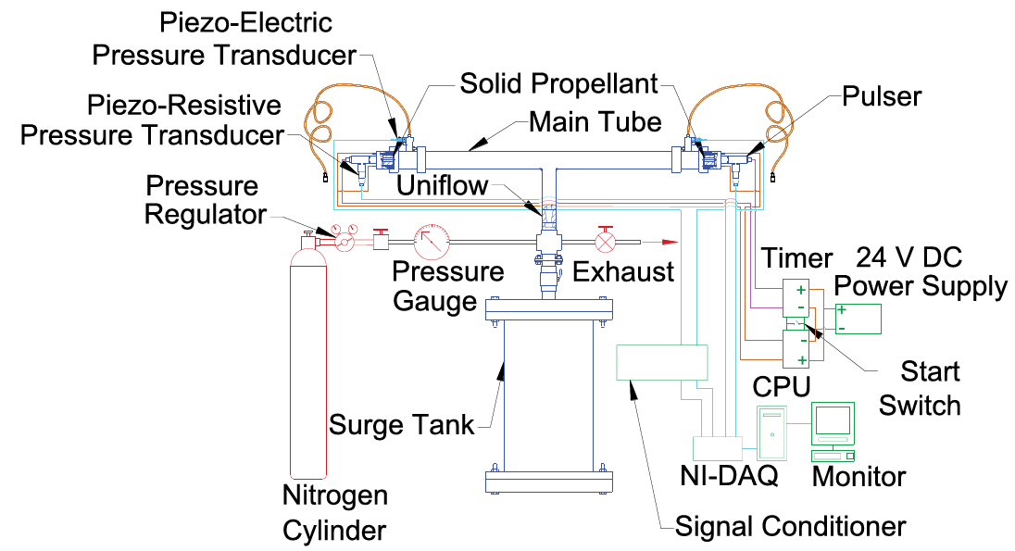
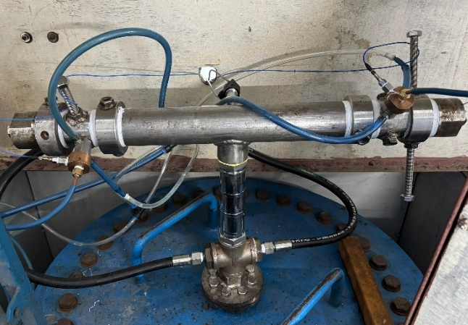
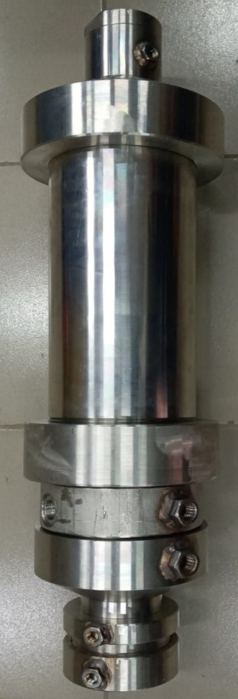
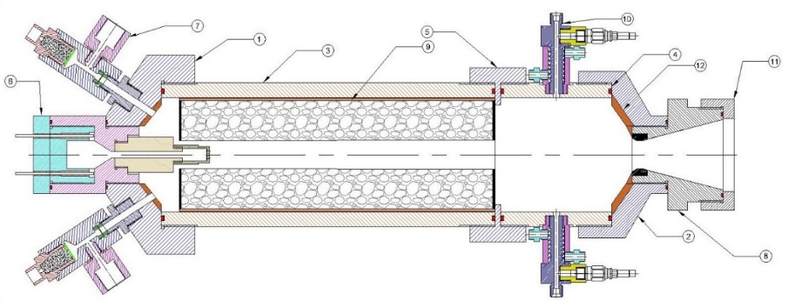
Combustion Response Measurement of Composite Solid Propellants using T-Burner and Pulsed BEM
Measures combustion response using the T-burner technique.
Characterizes pulsed T-burner tests for non-self-excited propellants.
Investigates the effect of initial grain temperature on combustion response.
Demonstrates the influence of propellant composition on stability.
Unifies self-excited and pulsed combustion response trends.
Predicts solid rocket motor stability using combustion response data.
Designing and manufacturing of a complete 3 kg BEM test motor for propellant evaluation.
Conducting tests at different acoustic frequencies to study combustion behavior.
Measurement of chamber pressure and burning performance during motor operation.
Generating combustion response data to improve the stability and safety of rocket motors.

Slide 5
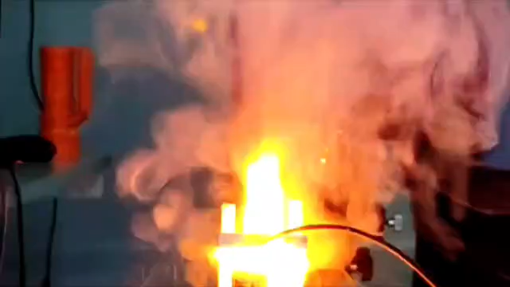
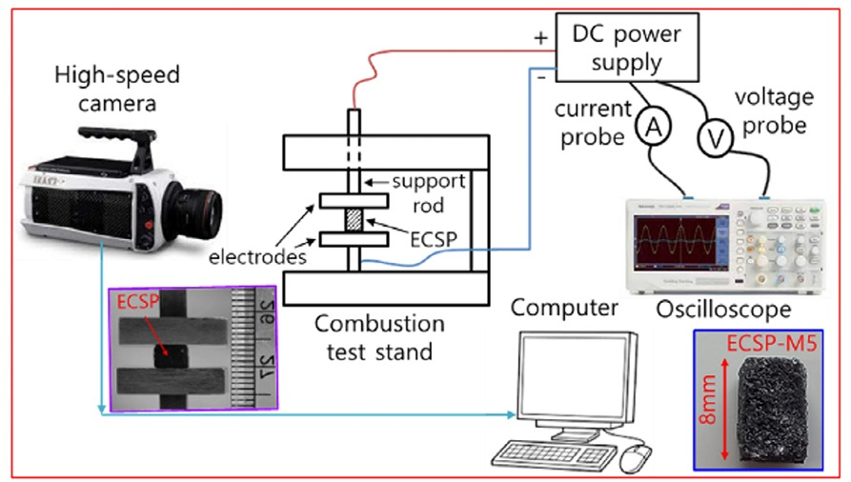
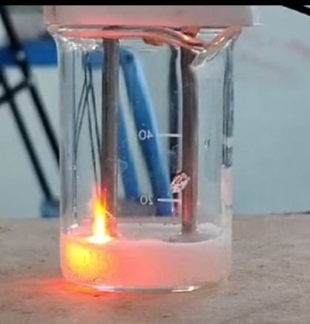
Development of Electrically Controlled Solid Propellants (ECSPs)
Development of electrically controlled solid propellants (ECSPs) with electrically initiated and controllable combustion.
Formulation and optimization of advanced oxidizer systems for enhanced ignition and combustion performance.
Development of PVA- and PEO-based polymer binder systems for electrically responsive propellants. Incorporation of metallic additives to improve energy release and combustion characteristics.
Integration of carbon-based conductive additives to enhance electrical conductivity and ignition reliability.
Investigation of catalytic additives for improved ignition and combustion efficiency.
Experimental evaluation of ignition, burn rate, combustion stability, and thrust performance. Design and development of ECSP-based micro-thrusters for advanced propulsion applications.
Research on ECSP applications for nano- and micro-satellites, spacecraft, missile attitude control, and gas generator systems.

Slide 6
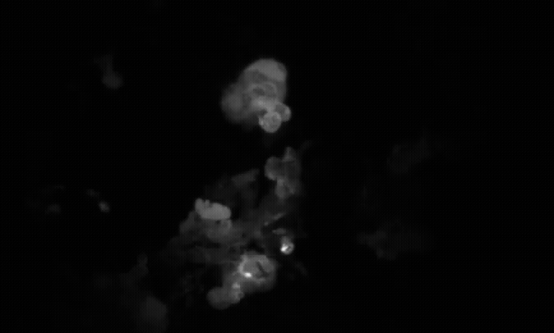
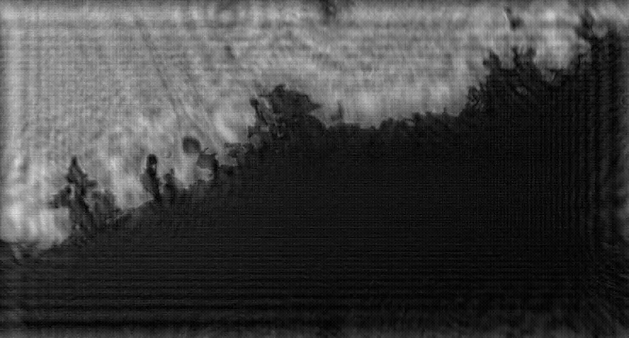
In-situ Measurements of Aluminum Agglomerate Size, Velocity, and Temperature Using Simultaneous Digital Inline Holography and Imaging Pyrometry
Integrated Digital Inline Holography (DIH) and imaging pyrometry diagnostic system
Real-time DIH reconstruction using machine learning for high-speed particle field analysis
Simultaneous measurements of aluminum agglomerate size, velocity, and temperature
Image processing algorithms for quantitative agglomerate temperature estimation
Thermo-physical characterization of agglomeration dynamics near the propellant burning surface
High-speed optical diagnostics of combustion and particulate evolution in composite solid propellants

Slide 7
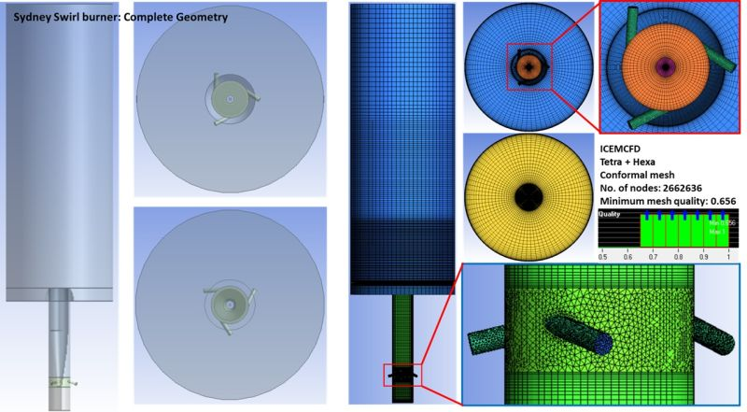
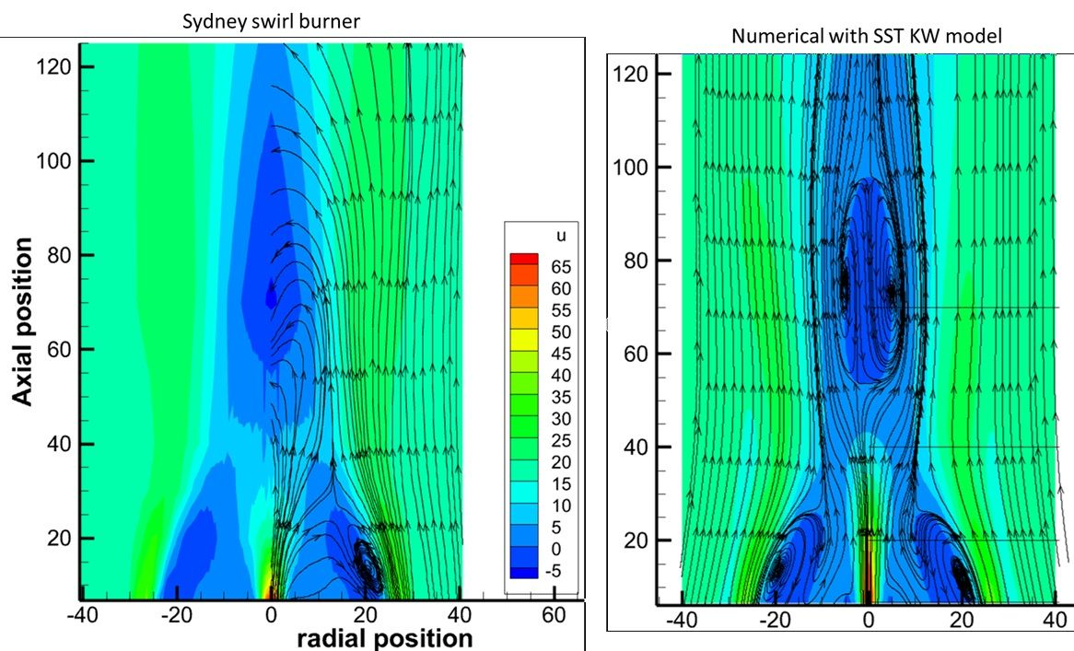
Experimental And Numerical Investigation Of Swirling And Non-swirling Flow For Gaseous (Methane And Ammonia) And Solid Fuels (Metal And Coal) Under Reacting And Non-reacting Conditions.
Investigation of flame topologies.
Flame stabilization modes (burner attached, lifted and swirling flames).
Reaction of ammonia with metals.
Effect of ammonia over metal combustion as pilot fuel.
Residue analysis of combustion product and flue gases.
Analysis of reaction mechanism for ammonia, aluminum and magnesium.

Slide 8
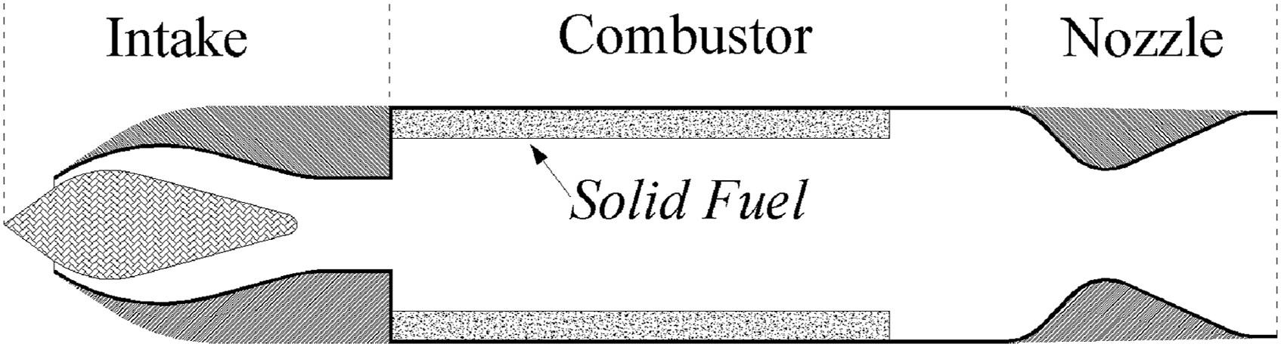
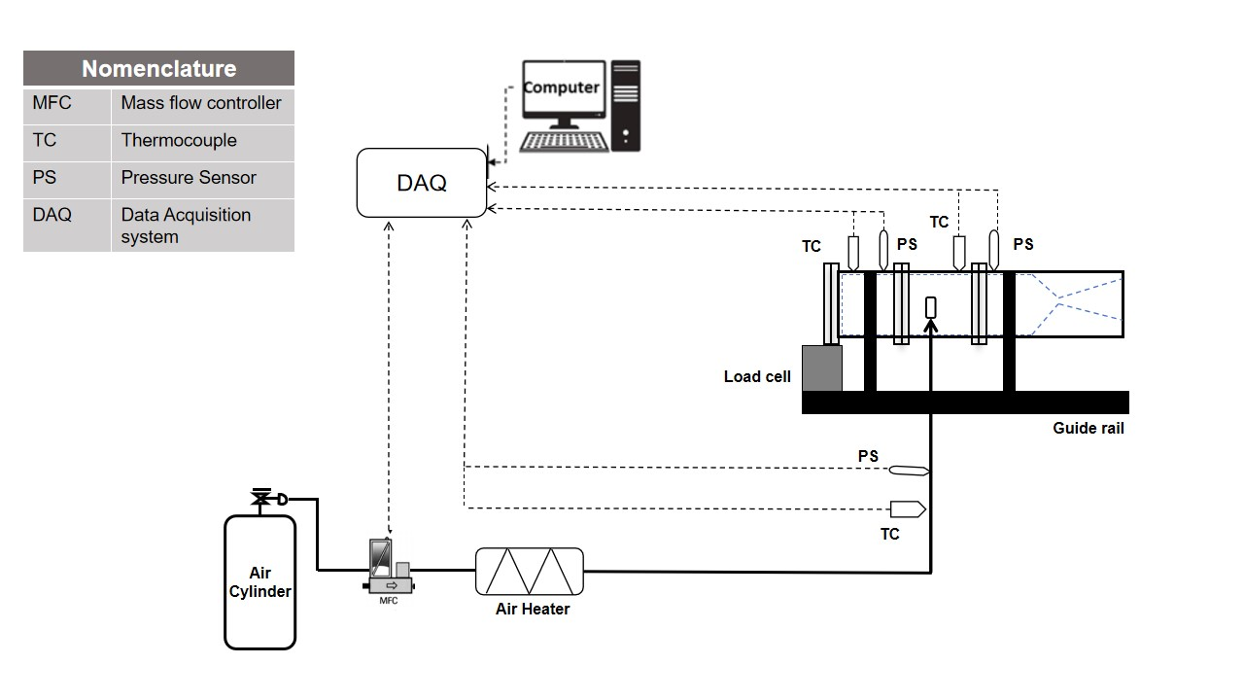
Solid Fuel Ducted Ramjet (SFDR) Propulsion
Development of high-energy boron-based composite fuels for Solid Fuel Ducted Ramjet (SFDR) propulsion.
Investigation of titanium and magnesium hydride additives to improve boron ignition and combustion efficiency.
Experimental evaluation of combustion characteristics, fuel regression, and thrust performance of SFDR fuels.
Characterization of combustion residues using advanced materials analysis techniques to understand reaction mechanisms.
Design and testing of laboratory-scale SFDR propulsion systems for high-speed air-breathing applications.
Optimization of fuel formulations to enhance propulsion efficiency and extend the operational range of next-generation missiles.

